Slide 1
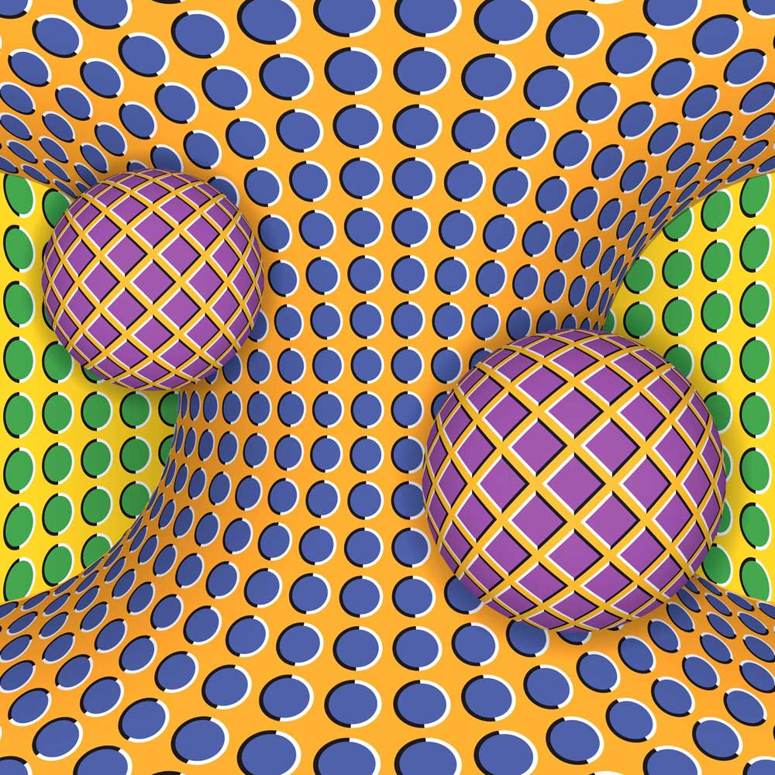

Slide 2
How To Bring Counseling Session Outcomes into the “Real” World: Microskills in Action
Friday, March 17 11:00am - 12:00pm Program ID #134, Room 3022 60-Minute Education Session, Advanced Allen E. Ivey, Carlos P. Zalaquett
This session will provide an introduction to attending and influencing skills followed by a description of the Empathic Relationship-Story and Strength-Goals-Restory-Action Model. A review of the model applied to the counseling session will be used to illustrate the micro-skills in action. Listening and focusing skills are used to examine clients’ issues. Clarification, genogram, confrontation, and reframing will be used to help clients resolve conflict and act more effectively. A Q&A conversation about the session will complete this program.

Slide 3
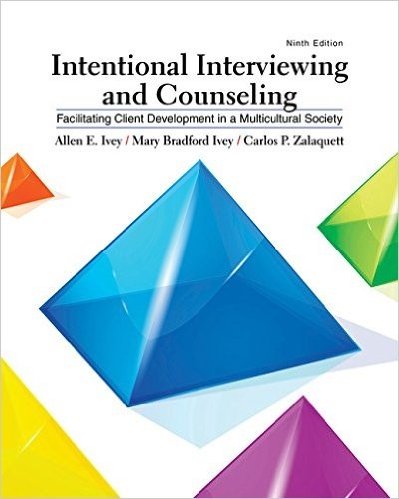
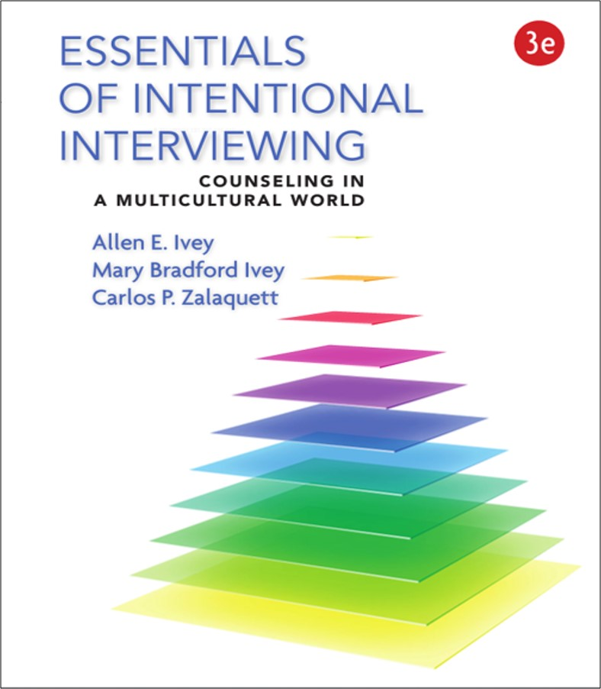
How To Bring Counseling Session Outcomes into the “Real” World: Microskills in Action
Program ID #134, Room 3022
11:00am - 12:00pm

Slide 4
How To Bring Counseling Session Outcomes into the “Real” World: Microskills in Action
Today’s Program
Introduction to attending and influencing skills
Description of the Empathic Relationship-Story and Strength-Goals-Restory-Action Model.
Demonstration of model applied to counseling: Nelida
Review of action strategies: Will you do it
Q&A

Slide 5
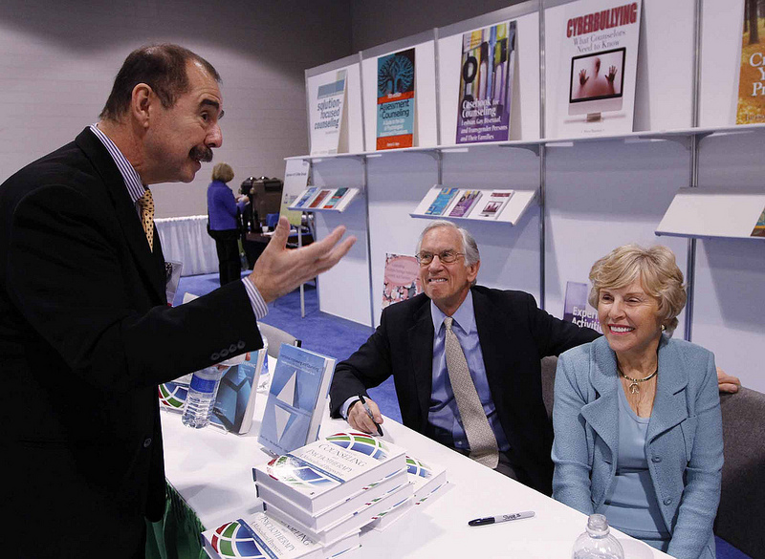
About the Presenters

Slide 6
About the Model

Slide 7
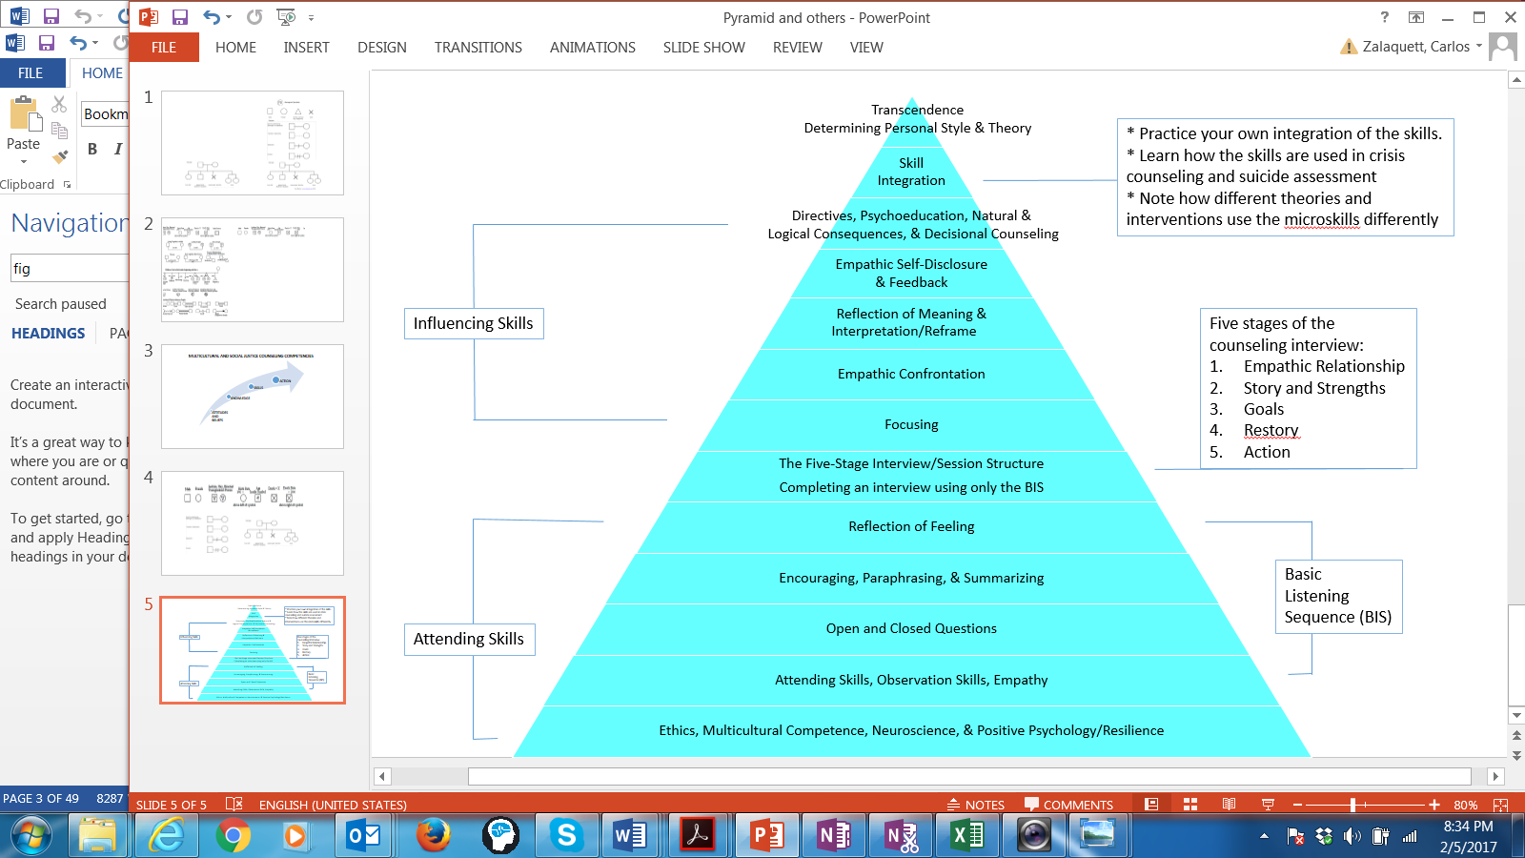
MICROSKILLS

Slide 8
Empathic Relationship-Story & Strength-Goals-Restory-Action Model

Slide 9
Five-Stage Interview Circle of Interviewing
Empathic Relationship
Initiating the Session
Rapport &
structuring
Action
Terminating. Generalizing
and acting on new stories
Story and Strengths
Gathering Data
Drawing out stories/issues
Positive Asset Search & Wellness
Restory
Working
Exploring alternatives
Goals
Set Mutual Goals
What does the client want to happen?

Slide 10
Stages of Counseling/Psychotherapy
Rapport and Relationship Building
Assessment/Problem Definition
Goal-setting
Initiating Interventions
Termination
Empathic Relationship
Story and Strengths
Goals (mutual)
Restory
Action
Ivey, A., Ivey, M. B., & Zalaquett, C. (2010, 2011, 2014, 2015, 2018).
Notes:
Cormier, S., & Hackney, H. (1999). Counseling Strategies and Interventions, 5th Edition.
Hackney, H., & Cormier, S. (2001). The Professional Counselor: A Process Guide to Helping, 4th Edition. Allyn & Bacon.
Michael D. Reiter (2007). Therapeutic Interviewing: Essential Skills and Contexts of Counseling, 1/e. Pearson.

Slide 12
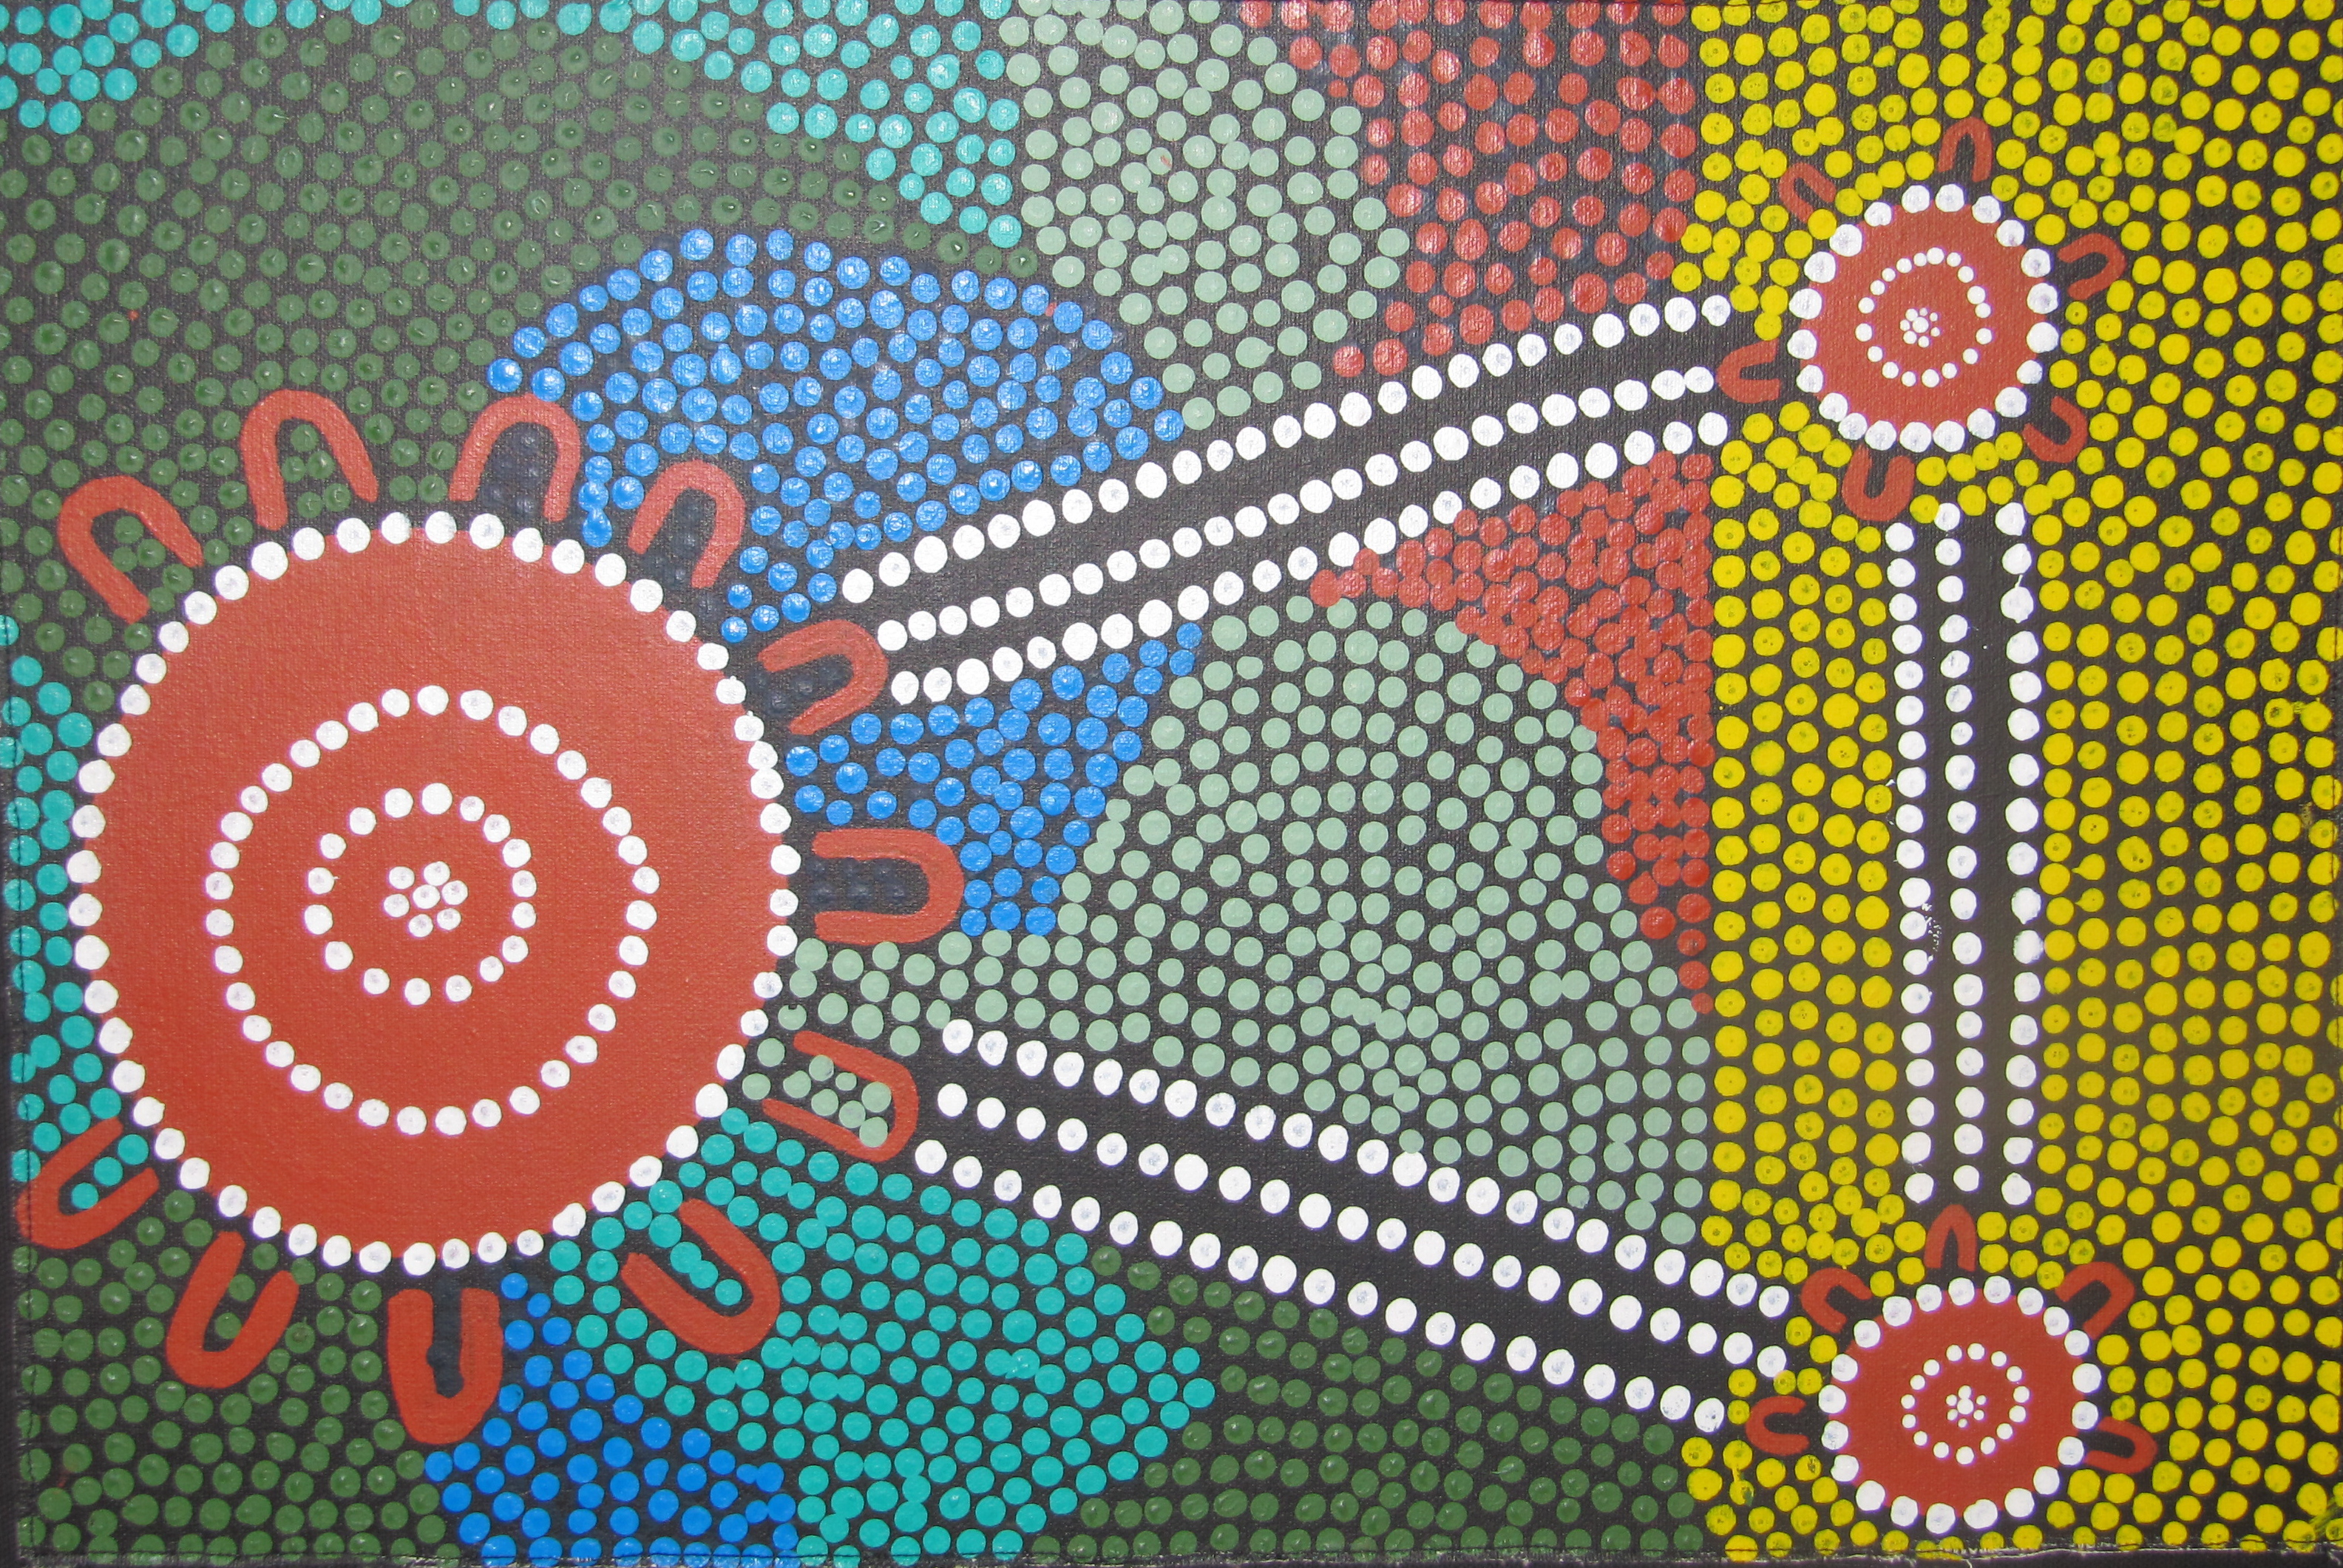
It takes a community to raise a child
There is danger in our
traditional autonomous self
Self-in-relation
Being-in-relation
Person-in-community

Slide 13
Community Genogram: The Person in Community
Individualistic counseling often fails to see individual in social context
Client generates a picture of their community in their own style.
Draw out stories, but focus on positives
Positives help client CENTER their being.
Keep 0n display during session
Grandparent’s home, high school, church, Mom’s home, local park

Slide 14
A Demonstration of the Community Genogram
Nelida’s background
Nely’s issue in USF class
Draw out stories on each dimension.
Focus on positives
Body Anchoring-Locating positive strengths in the body
May use later to explore issues and concerns

Slide 15
Body Anchoring Handout

Slide 16
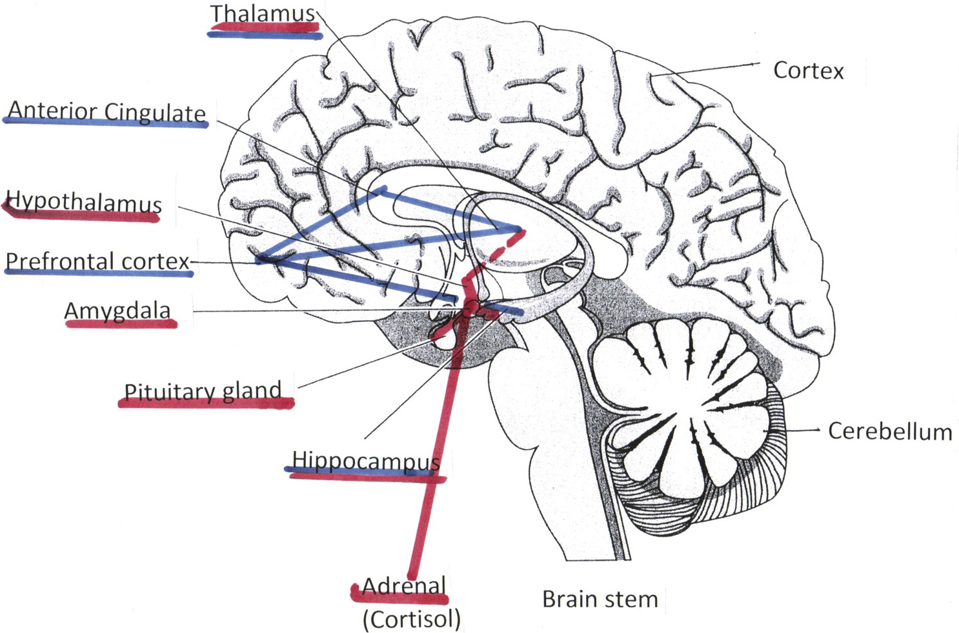
Cognitive Long Circuit Positive Emotions (TAP) Approximate locations
Thalamus
relay & attention
Anterior Cingulate
blood pressure,
decisions, empathy
Prefrontal cortex
executive,
positive emotions
(TAP, long circuit)
Hippocampus
memory
Nucleus accumbens
pleasure center
Dopamine
Positive emotions
primarily
in left frontal cortex

Slide 17
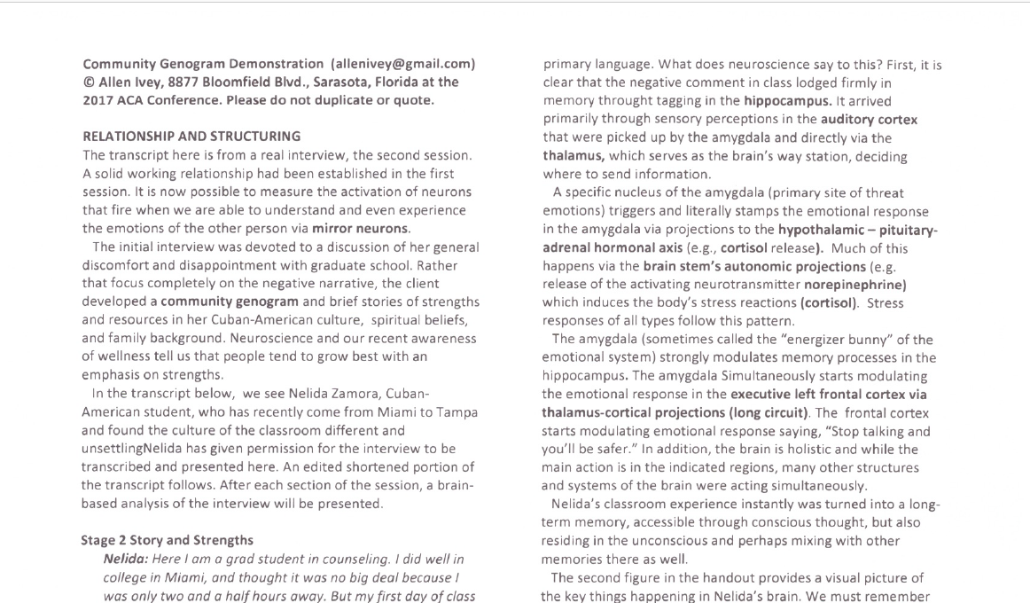
Please follow the handout

Slide 18
Stage 1. EMPATHIC RELATIONSHIP

Slide 19
Stage 2. STORY AND STRENGTHS

Slide 20
Video: Nelida Sensorimotor Body Anchoring
Allen interprets and reframes strengths
Positive family story—note importance of culture and context
Positive story from nature
Used for body anchoring
Aim for several anchors with clients

Slide 21
Anchoring the Positive Strength in the Body
Focus on one positive story in the community genogram
Select a positive image associated with that story
Here and now: “What are you seeing? Hearing? Feeling?”
Locate area in body where the feeling occurs.
Anchor in the body as a resource

Slide 22
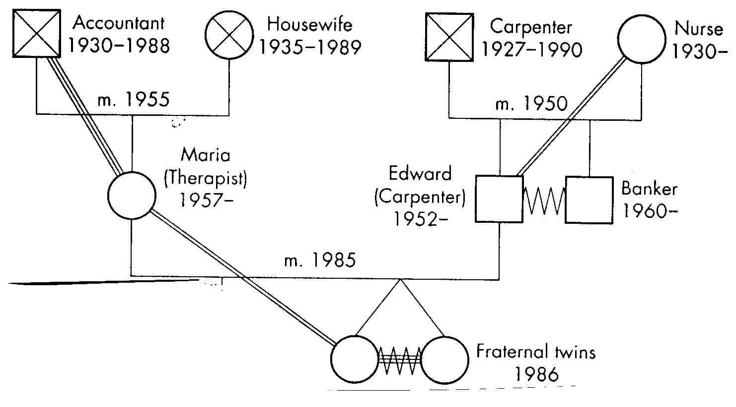
Family and Community Genograms
Complementary systems
But, some clients want to avoid family issues
Most clients show family of origin in the community genogram
Community genogram emphasizes strengths

Slide 23
Stage 3. GOAL SETTING

Slide 24
Stage 4. RESTORY

Slide 25
Stage 4. RESTORY
Go to Fuerza and How will you work with this
Generate four alternatives—educate, ignore, tell off (no), and I statement.
Share with family
Explain about Freire and psych as liberation

Slide 26
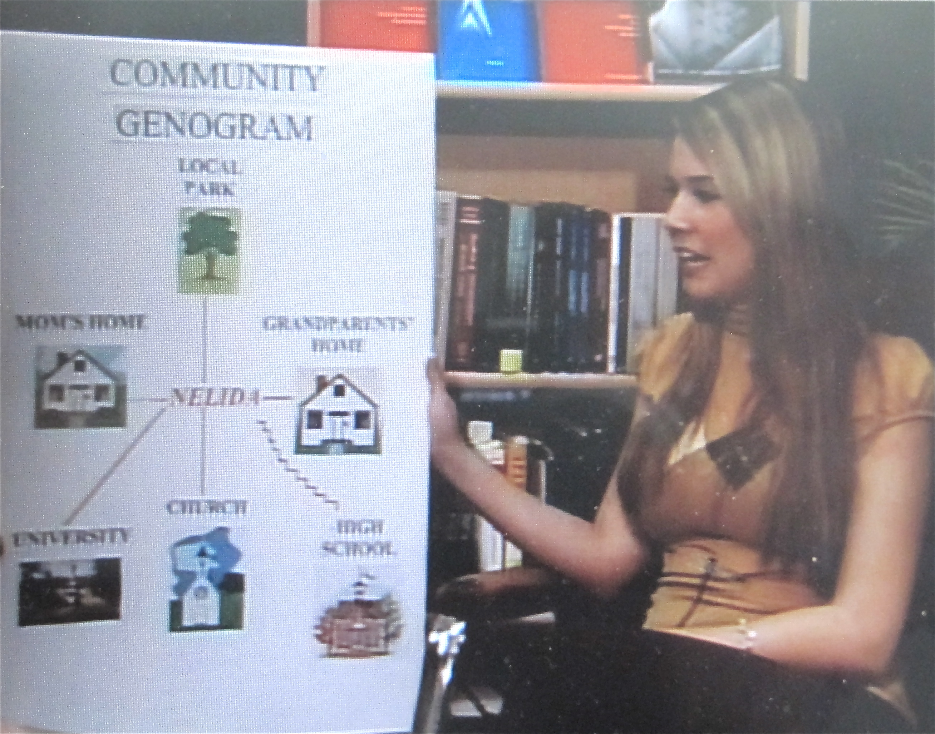
Helping Nely use the new reframing of the story

Slide 27
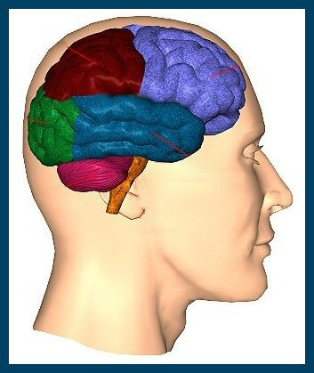
Different Areas of Frontal Lobe Activated
3
Background feelings
[primarily sensorimotor]
Attention to feelings
[concrete]
Reflective awareness
[formal & dialectic/systemic]
2
1

Slide 28
Stage 5. ACTION

Slide 29
Stage 5. ACTION
Review of strategies for action
What are you going to do tomorrow

Slide 30
Counseling and Therapeutic Implications

Slide 31
Counseling and Therapeutic Implications
Normalize, normalize, normalize.
Establish relationship representing solid attachment.
Have multiple treatment interventions available.
Don’t call client “resistant” to change.
Co-generate treatment alternatives that are personally meaningful and comprehensible to that client.

Slide 32
Counseling and Therapeutic Implications
The actions and thoughts of the therapist affect how the client thinks about and discusses issues in the interview. You cannot not affect the client’s world.
Join the client where he or she “is.”
Individuals cannot grow and progress unless a solid developmental foundation has been established.

Slide 33
Q & A

Slide 34
allenivey@gmail.com
cpz1@psu.edu

